Slide 1
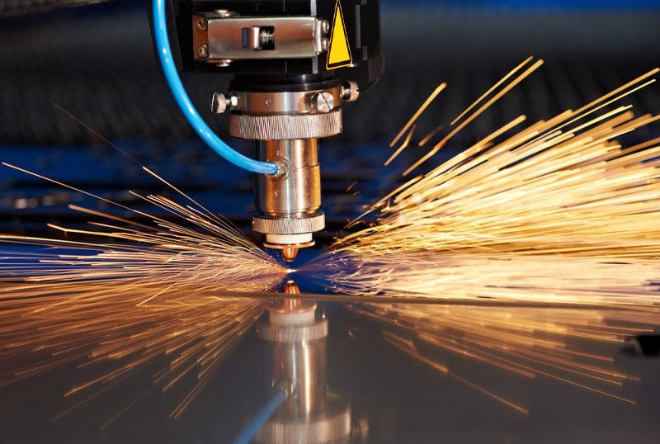


Energya Steel Fabrication
A World Class Steel Fabrication

Slide 2
Contents
Partners
(Suppliers & Clients)
Overview
Projects
Energya Steel Fabrication
01
02
03
04
05
06
Quality
Certificates
Products & Services
Performance
Certificates

Slide 3

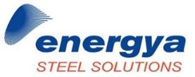

Organization Structure
Energya Steel Fabrication
EGYPT/KSA
EGYPT/KSA
EGYPT
Contents

Slide 4




Organization Structure
Energya Steel Fabrication
EGYPT
EGYPT
EGYPT
KSA
Contents

Slide 5
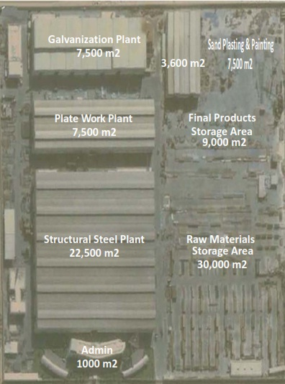
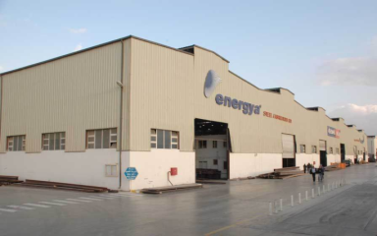
Facility
Energya Steel Fabrication
Total Land Area ≈ 150,000 SQM
Contents

Slide 6
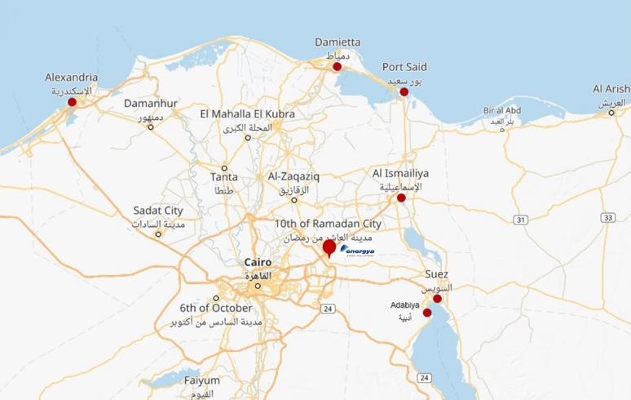
Location
Industrial Zone, 10th of Ramadan
Red Sea Ports near energya:
Ismailiya
Suez
Adabiya
Mediterranean Sea Ports:
Port Said
Damietta
Alexandria
Energya Steel Fabrication
Contents

Slide 7
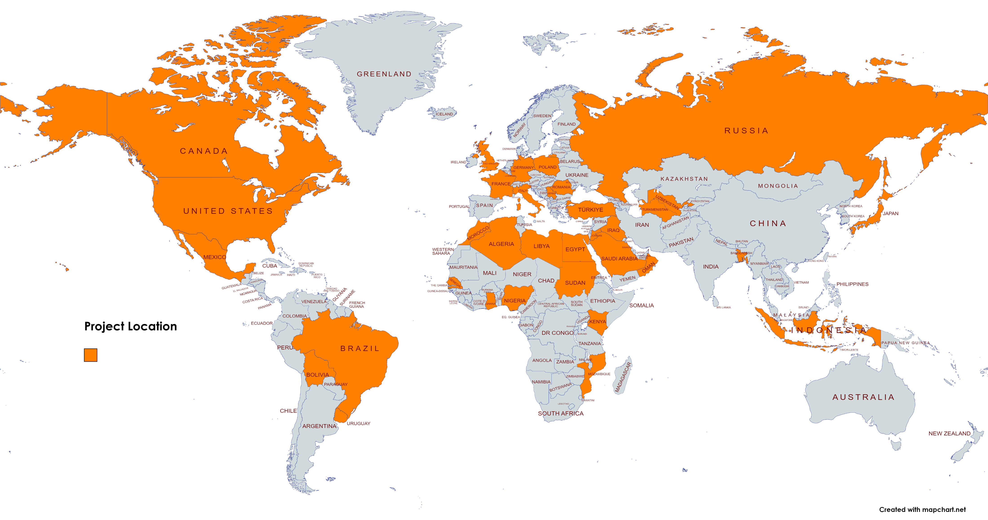
Global Reach
Energya Steel Fabrication
Projects in more than 37 countries
Contents

Slide 8
Our Staff
Energya Steel Fabrication
Department | No. of employees
Engineering | 25
Project Management | 12
QA/QC | 31
Erection | 219
Shop Floor | 975
Commercial | 8
Admin | 93
Total | 1,363
Contents

Slide 9
Engineering Capabilities
Energya works in accordance with the following Codes
American Institute for Steel Construction
American Petroleum Institute
American Society for Mechanical Engineers
American Welding Society
Euro Norm
Egyptian Code of Practice
Energya Steel Fabrication
Contents

Slide 10
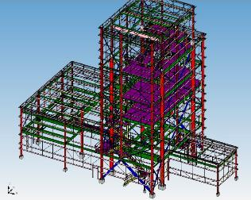
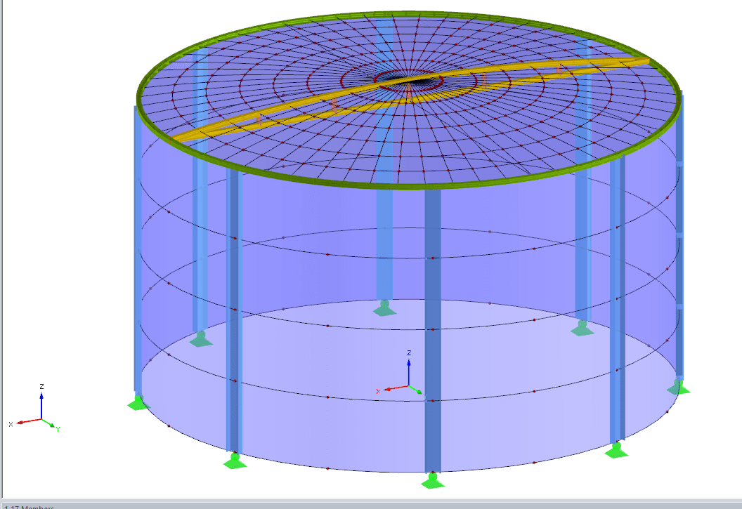
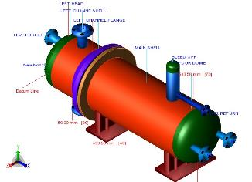
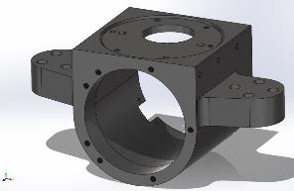
Engineering Capabilities
Energya use the following software for design, detailing & controlling
STAAD PRO 2008: Design of Structural Steel Members
SAP: Design of Structural Steel Members
PV ELITE: Design of Pressure Vessels
E TANK: Design of Storage Tanks
TEKLA: 3D Modeling and Shop Drawings
AUTODESK INVENTOR: 3D Modeling and Shop Drawings
SOLID WORKS: 3D Modeling and Shop Drawings
AUTOCAD
MS Project: Scheduling Software
ESF Data Base: Oracle in-house software to monitor the project at the different phases and document control.
Energya Steel Fabrication
Contents

Slide 11
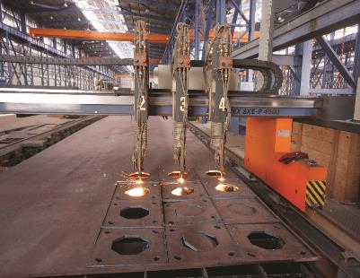
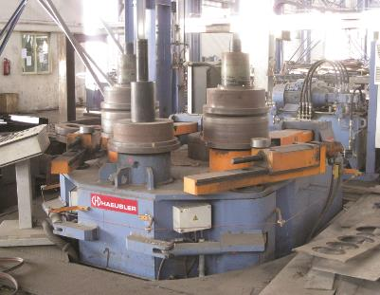
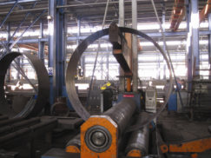
Equipment
In energya Plant, We have the following:
CNC Machines Including Angle Master Up To 200 x 200 X 25 mm, Plasma Cutting, Drilling, Built Up Section, Assemble Line, Band Saw, Punching, Shear Machines.
Plate Processing Machines Up To 150 mm thickness Including Rolling & Bending Up To 32 mm x 16 m.
Energya Steel Fabrication
Contents

Slide 12
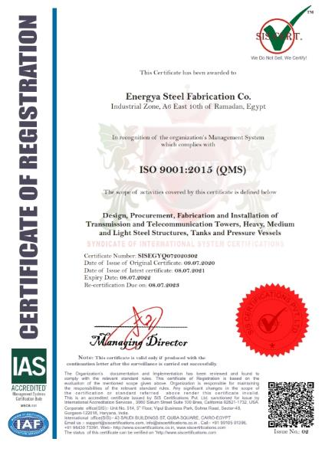
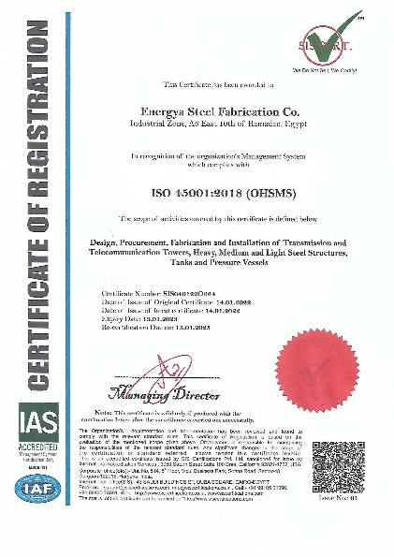
Quality Certificates - ISO
Energya Steel Fabrication
Contents

Slide 13
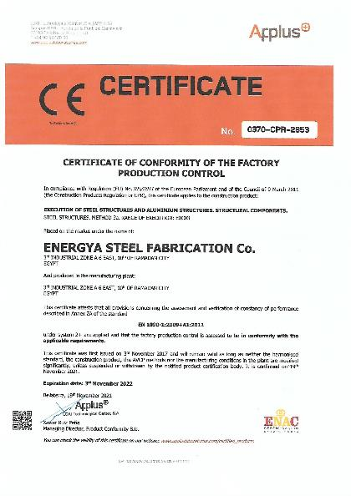
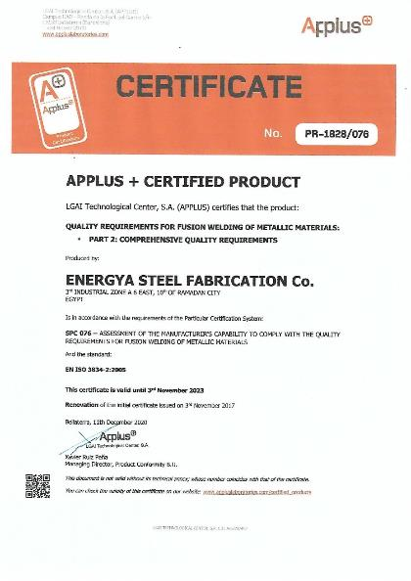
Quality Certificates - EN
Energya Steel Fabrication
Contents

Slide 14
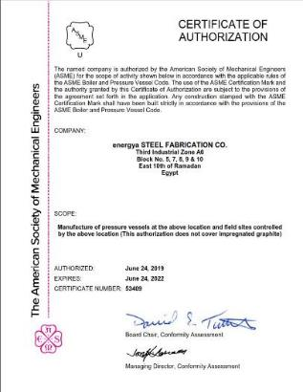
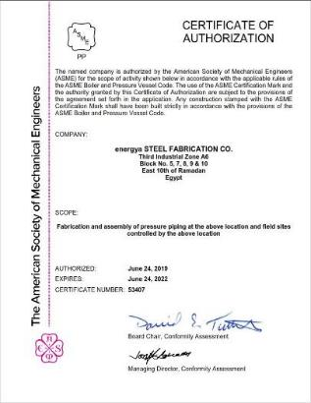
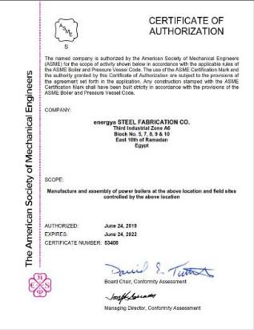
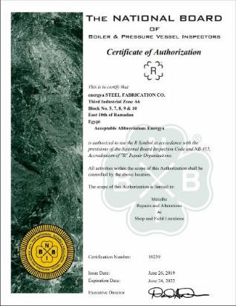
Quality Certificates - ASME
ASME Certifications (U, PP, S, & R stamps)
Energya Steel Fabrication
Contents

Slide 15






























Partners - Suppliers
Energya Steel Fabrication
Contents

Slide 16

























Partners - Clients
Energya Steel Fabrication
Contents

Slide 17






















Partners - Clients
Energya Steel Fabrication
Contents

Slide 18
Energya Steel Fabrication
Products & Services

Slide 19
Annual Production Capacity
Pre-Engineered Building
Steel Structure
01
04
24,000
Ton
12,000
Ton
Energya Steel Fabrication
02
05
Plate Work
Lighting Poles
12,000
Ton
12,000
Ton
03
06
Transmission / Telecom Towers
12,000
Ton
50,000
Ton
Galvanization
Contents

Slide 20
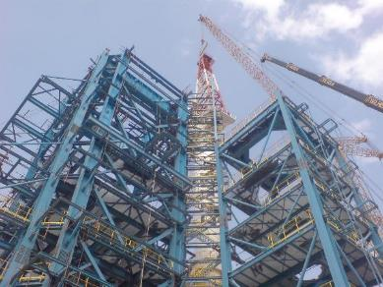
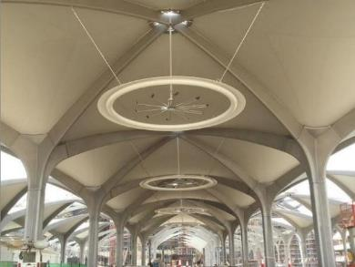
Steel Structure / Architecture Structure
Energya Steel Fabrication
Contents

Slide 21
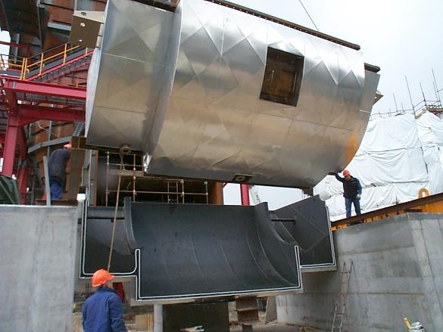
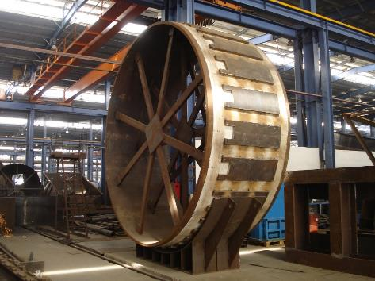
Process Equipment / Plate Work
Energya Steel Fabrication
Contents

Slide 22
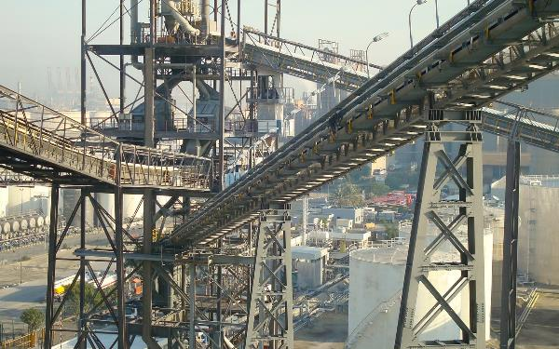
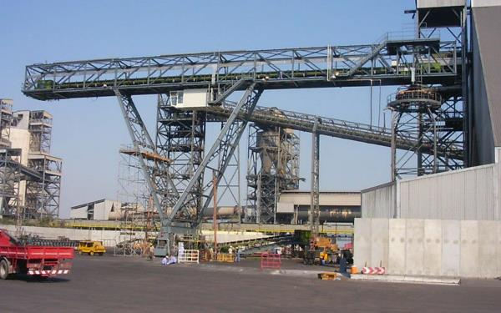
Material Handling Equipment
Fabrication & Erection of different types of Conveyors
Energya Steel Fabrication
Contents

Slide 23
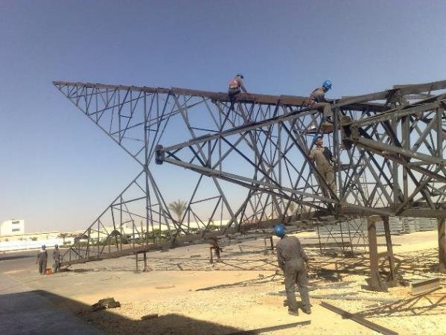
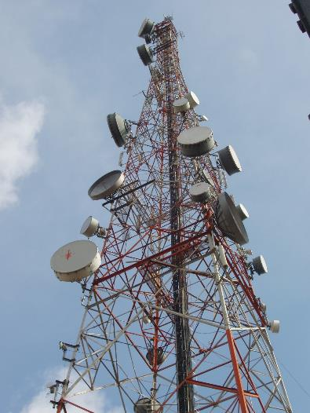
Transmission & Telecommunication Towers
Energya Steel Fabrication
Transmission Towers 66, 220 & 500 K.V
Telecommunication Towers up to 150m
Contents

Slide 24
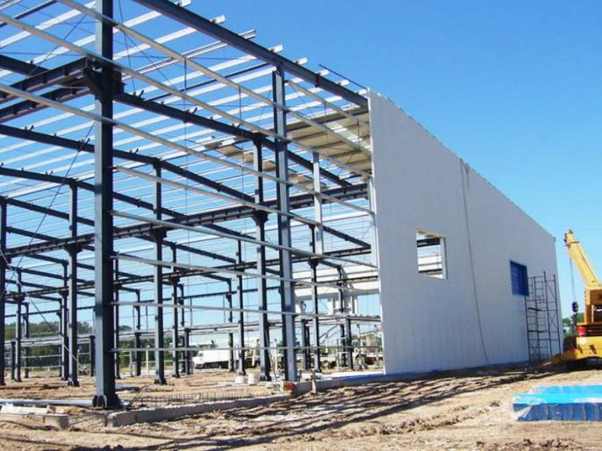
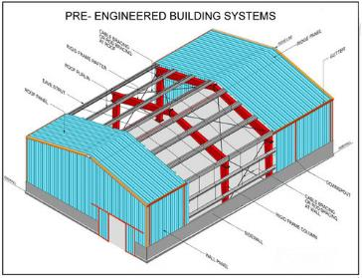
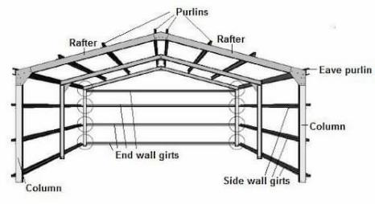
Pre-Engineered Building Systems
Energya Steel Fabrication
Contents

Slide 25
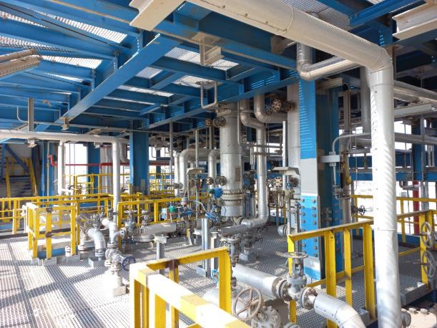
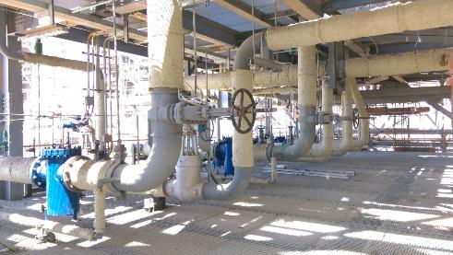
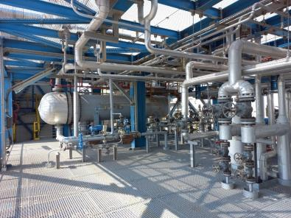
Piping System
Energya Steel Fabrication
Fabrication & Erection of Piping with different dimensions & pipe supports
Contents

Slide 26
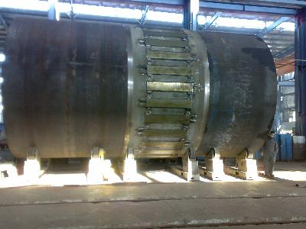
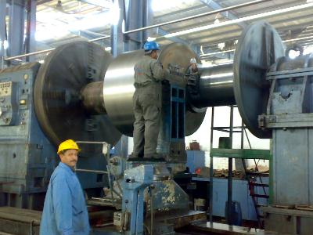
Machining
Energya Steel Fabrication
Contents

Slide 27
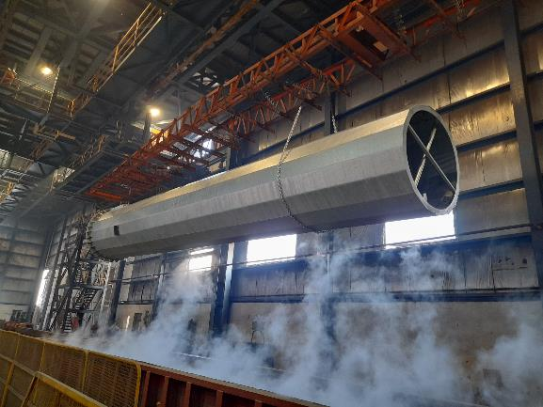
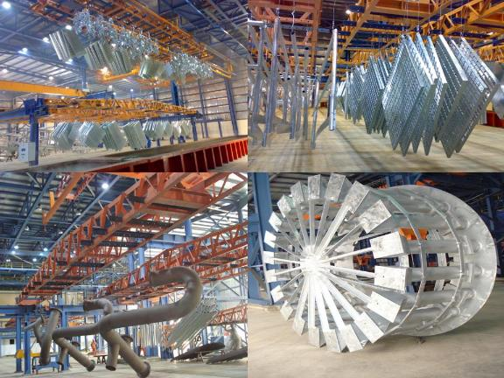
Galvanization
Kettle Dimension : 16.5 m (L) X 2 m (W) X 2.95 m (D)
Energya Steel Fabrication
Contents

Slide 28
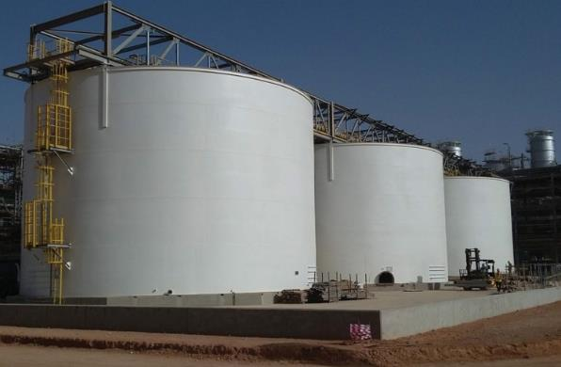
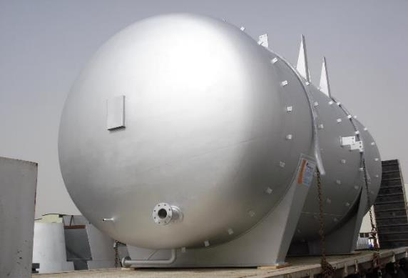
Storage Tanks & Pressure Vessels
ASME Code Pressure Vessels
Design of tanks as per API 650 Code
Energya Steel Fabrication
Contents

Slide 29
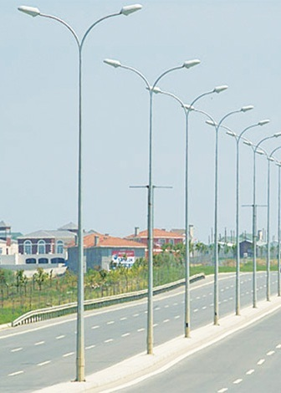
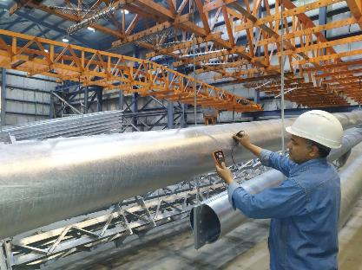
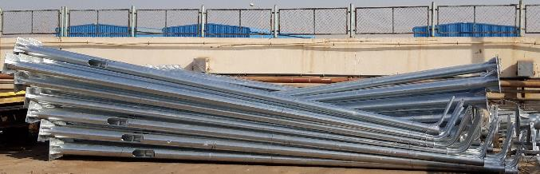
Lighting Poles
Energya Steel Fabrication
Contents

Slide 30
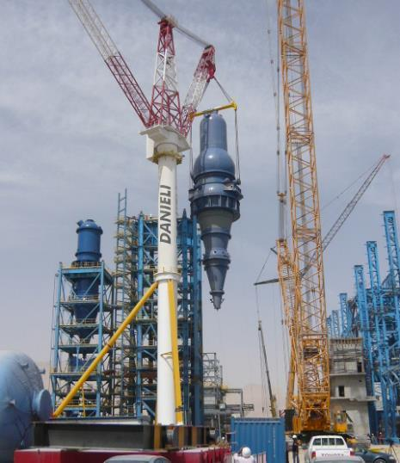
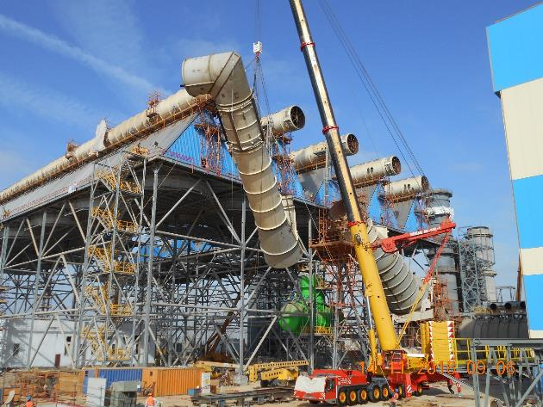
Erection Services
Mechanical Equipment, Electrical & Instrumentation
Steel Structure, Plate work & Piping
Energya Steel Fabrication
Contents

Slide 31
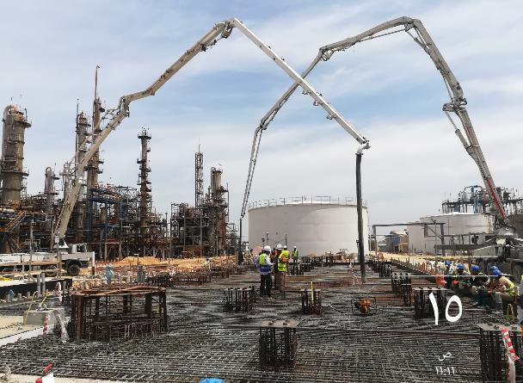
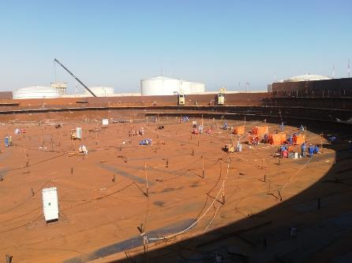
Turnkey Projects
Civil works, Piling, Fabrication, supply & installation
Energya Steel Fabrication
Contents

Slide 32
Energya Steel Fabrication
Projects Reference

Slide 33
Sectors We Serve
1
2
3
Energya Steel Fabrication
Cement
Power
Petrochemicals & Fertilizers
4
5
6
7
Industrial
Oil & Gas
Transportation
Construction
Contents

Slide 34
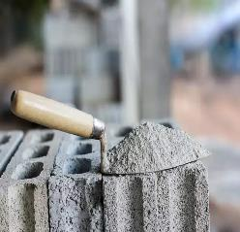
Cement Sector
Wadi El Nile Cement Plant
Beni Suef II Cement Plant
Misr Beni Suef Cement Plant
Arabian Cement Company
Helwan Cement Plant
Cement Plant USA
Suez Cement Plant
Energya Steel Fabrication
Contents
Cement
Sectors

Slide 35
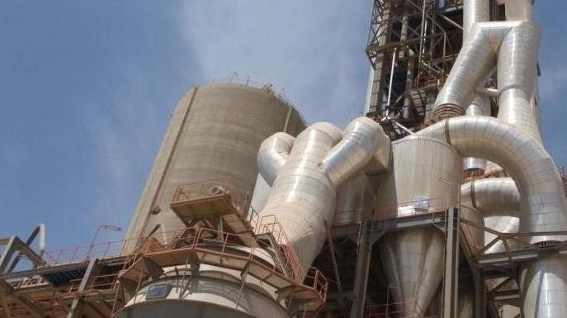
Wadi El Nile Cement Plant
Energya Steel Fabrication
Contents
Cement
Sectors

Slide 36



Wadi El Nile Cement Plant
Client
Wadi El Nile Co.
Location
Beni Suef
Quantity
Scope
11,500 Ton
Fabrication & erection of Steel Structure
Fabrication & erection of BSD Equipment
Fabrication & erection of Ducts
Erection of mechanical equipment
Energya Steel Fabrication
Contents
Cement
Sectors

Slide 37




Beni Suef 2 Cement Plant
Client
Fives FCB
Location
Egypt
Quantity
Scope
7,400 Ton
Supply & fabrication of Steel Structure
Supply & fabrication of plate works
Design, supply & fabrication of 11 Belt Conveyors
Energya Steel Fabrication
Contents
Cement
Sectors

Slide 38



Misr Beni Suef Cement Plant
Client
Polysius
Location
Beni Suef
Quantity
Scope
6,200 Ton
Supply & fabrication steel structure & plate works
Energya Steel Fabrication
Contents
Cement
Sectors

Slide 39

Helwan Cement Plant
Energya Steel Fabrication
Contents
Cement
Sectors

Slide 40




Helwan Cement Plant
Client
BOLDROCCHI
Location
Helwan
Quantity
Scope
2,000 Ton
Demolishing of Electrostatic precipitators filters
Fabrication & erection of new filters
Fabrication & erection of Ducts
Fabrication & erection of Stacks.
Energya Steel Fabrication
Contents
Cement
Sectors

Slide 41


Arabian Cement Company
Client
Arabian Cement Co.
Location
Egypt
Quantity
Scope
1,000 Ton
Supply & fabrication of 2 cement mills shell
Supply & fabrication of kiln shell
Energya Steel Fabrication
Contents
Cement
Sectors

Slide 42




Lehigh Mitchell K4 Cement Project - USA
Client
Redecam Group
Location
USA
Quantity
Scope
300 Ton
Supply & fabrication of filters & Heat Exchanger
Energya Steel Fabrication
Contents
Cement
Sectors

Slide 43


Suez Cement Plant
Client
Heidelberg Cement
Location
Suez
Quantity
Scope
200 Ton
Supply & fabrication of Kiln shell length 18m & thickness 25mm
Energya Steel Fabrication
Contents
Cement
Sectors

Slide 44

Power Sector
Besmaya Power Plant - ACC
Al Shabab Power Plant
Assuit Barrage & Hydropower Plant
220 KV Double Circuit OHTL – Toshka2/Wadi Haifa
Assuit & Cairo West Plants
Banha Power Station - HRSG
6th October Power Plant - Piping
Energya Steel Fabrication
Contents
Power
Sectors

Slide 45




Besmaya II / III Power Plant – Air Cooled Condensers
Client
Enexio
Location
Iraq
Quantity
Scope
2 x 8,500 Ton
Supply & fabrication steel structure
Supply & fabrication of piping & piping supports for 2 units of ACC
Supply & fabrication of ducts & plate works
Energya Steel Fabrication
Contents
Power
Sectors

Slide 46

Al Shabab Power Station – Air Cooled Condensers
Energya Steel Fabrication
Contents
Power
Sectors

Slide 47




Al Shabab Power Station – Air Cooled Condensers
Client
Enexio
Location
Ismailia - Egypt
Quantity
Scope
9,000 Ton
Fabrication & erection of steel structure & plate works
Fabrication & erection of tanks & deaerator
Fabrication & erection of piping
Energya Steel Fabrication
Contents
Power
Sectors

Slide 48

Banha Power Station - HRSG
Energya Steel Fabrication
Contents
Power
Sectors

Slide 49




Banha Power Station - HRSG
Client
Ansaldo Caldaie SPA
Location
Egypt
Quantity
Scope
7,000 Ton
Fabrication & erection of main & secondary steel structure
Fabrication & erection of plate works
Fabrication & erection of IP & LP Drums
Energya Steel Fabrication
Contents
Power
Sectors

Slide 50

6th October Power Plant
Energya Steel Fabrication
Contents
Power
Sectors

Slide 51




6th October Power Plant
Client
Ansaldo Energia
Location
Egypt
Quantity
Scope
21,000 Dia. Inch
Fabrication & erection of carbon steel, stainless steel & alloyed steel piping
Installation of the underground piping including HDPE.
All piping supports with more than 42 MT.
Energya Steel Fabrication
Contents
Power
Sectors

Slide 52

Assuit Barrage & Hydropower Plant
Energya Steel Fabrication
Contents
Power
Sectors

Slide 53




Assuit Barrage & Hydropower Plant
Client
Andritz Hydro GmbH
Location
Egypt
Quantity
Scope
3,200 Ton
Supply & fabrication of stoplogs & Culvert Gates
Supply & fabrication of Radial Gates & Navigation Locks
Supply & fabrication of Steel Structure
Energya Steel Fabrication
Contents
Power
Sectors

Slide 54



220 KV Double Circuit OHTL – Toshka / Wadi Haifa
Client
Larsen & Tubro
Location
Egypt - Sudan
Quantity
Scope
1,200 Ton
Supply, fabrication & galvanization of transmission tower including Nile crossing towers
Energya Steel Fabrication
Contents
Power
Sectors

Slide 55



Assuit & Cairo West Plants
Client
Veolia Water
Location
Egypt
Quantity
Scope
260 Ton
Engineering, supply, fabrication & ASME inspection for Pressure Vessels
Energya Steel Fabrication
Contents
Power
Sectors

Slide 56

Petrochemicals & Fertilizers Sector
1200 TPD PET Chips Plant
New EDC Cracking Unit
Arab Potash Project
NCIC Plant
Energya Steel Fabrication
Contents
Fertilizer
Sectors

Slide 57

1200 TPD Pet Chips Plant
Energya Steel Fabrication
Contents
Fertilizer
Sectors

Slide 58




1200 TPD Pet Chips Plant
Client
EIPET
Location
Ain Soukhna
Quantity
Scope
2,900 Ton
Fabrication & erection of Steel Structure
Fabrication & erection of Tanks
Fabrication & erection of Piping
Electrical & Instrumentation Equipment
Energya Steel Fabrication
Contents
Fertilizer
Sectors

Slide 59

New EDC Cracking Unit
Energya Steel Fabrication
Contents
Fertilizer
Sectors

Slide 60




New EDC Cracking Unit
Client
ThyssenKrupp Industrial Solutions
Location
Amerya - Egypt
Quantity
Scope
Piling & Civil Works
Fabrication & erection of Piping
Installation of Mechanical Equipment
Fabrication & erection of Steel Structure
770 Ton Steel Structure
3,900 m Piling & Civil Works
33,000 Dia. Inch Piping
Energya Steel Fabrication
Contents
Fertilizer
Sectors

Slide 61
Arab Potash Project
Client
Petrojet
Location
Jordan
Quantity
Scope
6,000 Ton
Supply & fabrication of Steel Structure
Energya Steel Fabrication
Contents
Fertilizer
Sectors

Slide 62


NCIC Plant
Client
ThyssenKrupp Industrial Solutions
Location
Egypt
Quantity
Scope
30 Ton
Supply & fabrication of Storage Bin
Energya Steel Fabrication
Contents
Fertilizer
Sectors

Slide 63

Industrial Sector
Suez Steel Plant
Food City
Nile Sugar Factory
Ezz Dekhila Plant
Paper Factory
Energya Steel Fabrication
Contents
Industry
Sectors

Slide 64

Suez Steel Plant
Energya Steel Fabrication
Contents
Industry
Sectors

Slide 65




Suez Steel Plant
Client
Suez Steel Co.
Location
Egypt
Quantity
Scope
15,000 Ton
Fabrication & erection of Steel Structure & Plate Works
Erection of mechanical equipment
Fabrication & erection o Piping
Electrical & instrumentation Equipment
Energya Steel Fabrication
Contents
Industry
Sectors

Slide 66



Food City
Client
Protection for Contracting & Design
Location
Sadat City - Egypt
Quantity
Scope
12,000 Ton
Fabrication & erection of Steel Structure & Sandwich Panels
Energya Steel Fabrication
Contents
Industry
Sectors

Slide 67




Nile Sugar Company
Client
Nile Sugar Co.
Location
Egypt
Quantity
Scope
7,000 Ton
Fabrication & erection of Steel Structure
Fabrication & erection o tanks
Metal Cladding
Energya Steel Fabrication
Contents
Industry
Sectors

Slide 68

EZZ El Dekhila Plant
Energya Steel Fabrication
Contents
Industry
Sectors

Slide 69




EZZ El Dekhila Plant
Client
EZZ Dekhila Co.
Location
Alexandria
Quantity
Scope
3,000 Ton
Fabrication & erection of Steel Structure & Plate Works
Energya Steel Fabrication
Contents
Industry
Sectors

Slide 70

Paper Factory
Energya Steel Fabrication
Contents
Industry
Sectors

Slide 71




Paper Factory
Client
Interpac
Location
10 of Ramadan - Egypt
Quantity
Scope
720 Ton
Fabrication & erection of Steel Towers
Fabrication & erection of Tanks
Fabrication & erection of piping
Energya Steel Fabrication
Contents
Industry
Sectors

Slide 72

Oil & Gas Sector
Crude Oil Storage Tank Farm
Zohr Project
Qarun Petroleum Project
Ras Ghareb Separators Skid
Dangote Oil Refinery
Energya Steel Fabrication
Contents
Oil & Gas
Sectors

Slide 73

Crude Oil Storage Tanks Farm
Energya Steel Fabrication
Contents
Oil & Gas
Sectors

Slide 74



Crude Oil Storage Tanks Farm
Client
Petrojet
Location
Suez - Egypt
Quantity
Scope
3,400 Ton
Erection of Crude Oil Tanks
Energya Steel Fabrication
Contents
Oil & Gas
Sectors

Slide 75




Zohr Project
Client
Petrojet
Location
Egypt
Quantity
Scope
2,800 Ton
Supply & fabrication of Steel Structure
Energya Steel Fabrication
Contents
Oil & Gas
Sectors

Slide 76





Dangote Oil Refinery
Client
John Zink
Location
Nigeria
Quantity
Scope
1,200 Ton
Supply & fabrication of Stacks
Supply & fabrication of Incinerators Chamber
Energya Steel Fabrication
Contents
Oil & Gas
Sectors

Slide 77

Qarun Petroleum Project
Client
SAN MISR
Location
Egypt
Quantity
Scope
250 Ton
Supply & fabrication of 3 phase production Separator
Energya Steel Fabrication
Contents
Oil & Gas
Sectors

Slide 78



Ras Ghareb Separators Skid
Client
Delta Process Systems
Location
Egypt
Quantity
Scope
50 Ton
Supply & fabrication of 2 Separators Skids of Pressure Vessels
Energya Steel Fabrication
Contents
Oil & Gas
Sectors

Slide 79

Transportation Sector
Hurghada International Airport
Cairo International Airport
Rabigh Railway Station
Energya Steel Fabrication
Contents
Trans.
Sectors

Slide 80



Rabigh Railway Station
Client
Dar El Handasa
Location
Saudi Arabia
Quantity
Scope
10,000 Ton
Fabrication & erection of Architectural Structure
Energya Steel Fabrication
Contents
Trans.
Sectors

Slide 81



Hurghada International Airport
Client
El Marasem International for Development
Location
Egypt
Quantity
Scope
8,000 Ton
Fabrication & erection of Steel Structure
Energya Steel Fabrication
Contents
Trans.
Sectors

Slide 82



Cairo International Airport – Seasonal Flight Terminal
Client
Orascom
Location
Egypt
Quantity
Scope
1,200 Ton
Fabrication & erection of Main Truss
Cladding & Sandwich Panels Works
Energya Steel Fabrication
Contents
Trans.
Sectors

Slide 83

Construction Sector
El Galala Marble & Granite Factory
Geneva Bridge
Cow Farm
Emaar Bridge
Energya Steel Fabrication
Contents
Const.
Sectors

Slide 84




El Galala Marble & Granite Factory
Client
Archirodon Construction
Location
Egypt
Quantity
Scope
3,500 Ton
Fabrication & erection of Steel Structure
Fabrication & erection of Tanks
Energya Steel Fabrication
Contents
Const.
Sectors

Slide 85

Cow Farm
Energya Steel Fabrication
Contents
Const.
Sectors

Slide 86




Cow Farm
Client
Protection for Contracting & Design
Location
New Wadi - Egypt
Quantity
Scope
2,200 Ton
Fabrication & erection of Steel Structure
Energya Steel Fabrication
Contents
Const.
Sectors

Slide 87

Geneva Bridge
Energya Steel Fabrication
Contents
Const.
Sectors

Slide 88

Geneva Bridge
Client
General Nile for Roads & Bridges
Location
Egypt
Quantity
Scope
2,000 Ton
Fabrication & erection of Steel Bridge
Energya Steel Fabrication
Contents
Const.
Sectors

Slide 89



Emaar Bridge
Client
Hassan Allam Steel
Location
Egypt
Quantity
Scope
400 Ton
Fabrication of Steel Bridge
Energya Steel Fabrication
Contents
Const.
Sectors

Slide 90



Performance Certificates
Energya Steel Fabrication
Contents

Slide 91


Performance Certificates
Energya Steel Fabrication
Contents

Slide 92
Web Site
www.energyasteel.com
WhatsApp
+20 1001727163
Energya Steel Fabrication
E-mail
Sales@energyasteel.com
Contact Us
Land Line
+20 554 412 248 / 49
Fax
+20 554 412 236
Address
Third Industrial Zone, 6A East - 10 of Ramadan City
Contents

Slide 93
Energya Steel Fabrication
Thank you
☺

